Slide 1

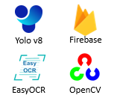
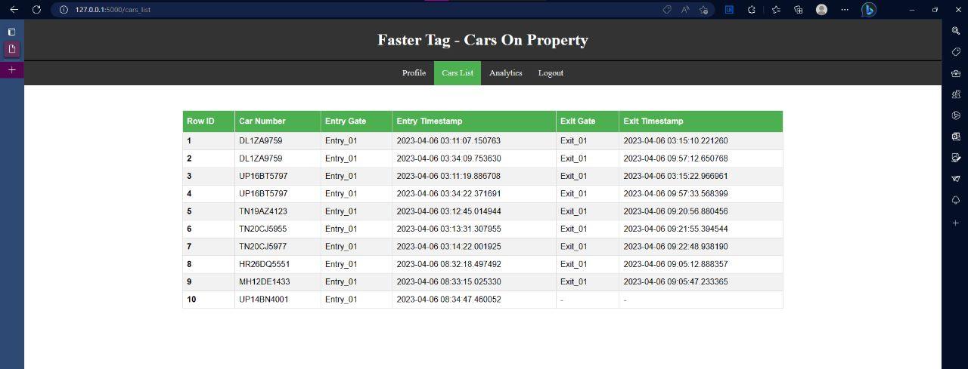
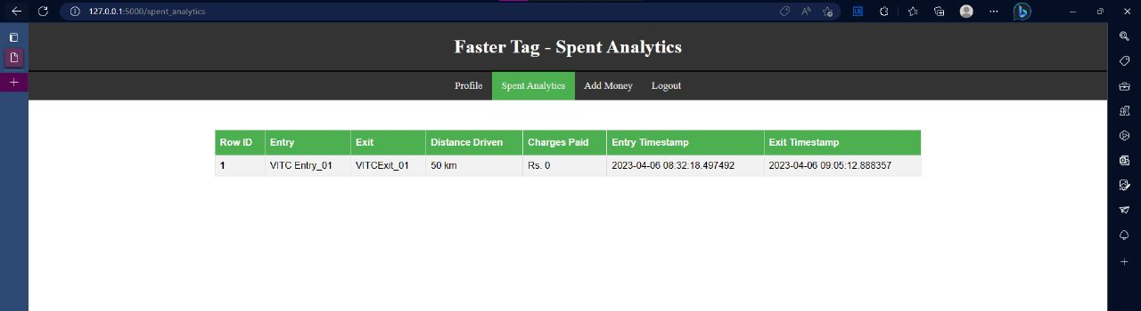
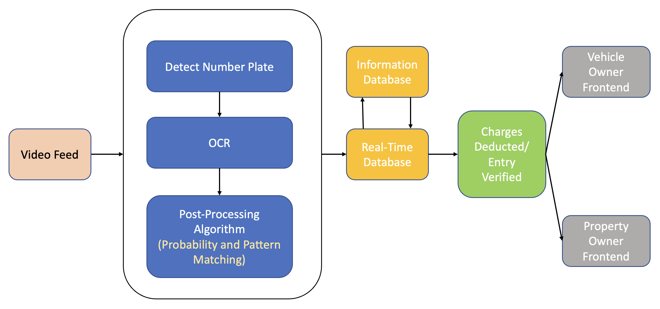
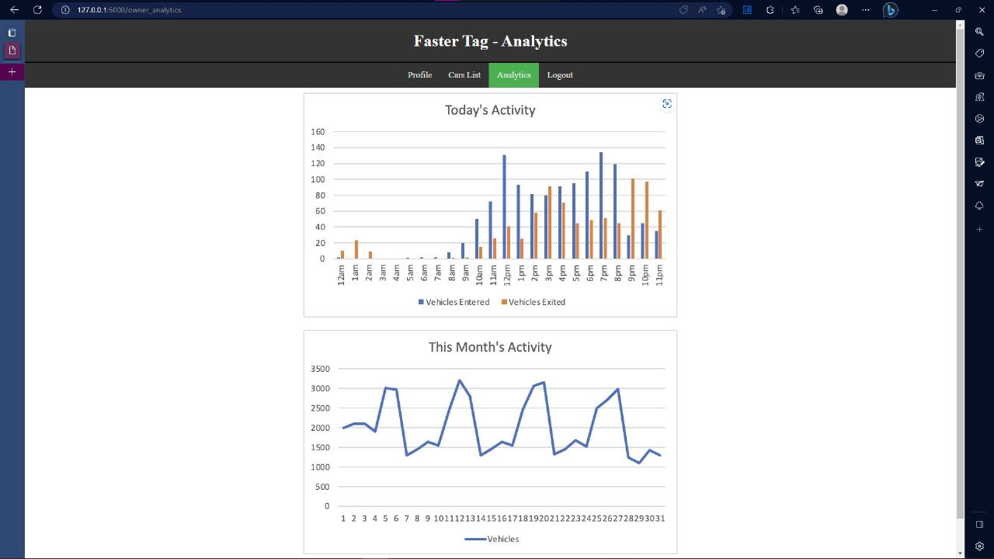
Fastertag
Sahil Amritkar (20BRS1180), Yukta Bhatti (20BRS1090), Hritik Goel (20BRS1035), Kritish Palrecha (20BRS1074)
Dr. Harini S
SCOPE
INDUSTRY CONCLAVE 2023
INTRODUCTION
A stop-less ANPR Vehicle Management System.
The following are the problems with the current system, which motivated us to work on this project.
FastTag:
→ Still need to stop the car
→ congestion
GPS based system
→ Expensive to install on all Cars
→ Privacy Issues
Indian Number Plates:
→ Too many styles
→ ANPR is Hard
Objectives
Our objective is to create a system that:
Has no stop entry, exits and toll collection
Has no chance of traffic congestion and increased efficiency
Has privacy protection
Is easily deployable and scalable
Has enhanced security
Can be integrated with smart cities
Has key analytics for property owner
Is convenient for the User
SCOPE of the project
This has use cases in
toll collection
parking management
campus authorization.
methodology
We are using the following technology.
YOLO v8
EasyOCR
OpenCV
Firebase
Flask
Architecture
The cameras send their video feed to a server. The video feed is analyzed, a number plate is detected using YOLO (trained on number plates), then using an OCR (EasyOCR) we read the text. We then pass the detected texts into our Indian number plates extraction algorithm. This post processing algorithm uses a series of probabilistic and pattern matching techniques to find the most likely number plate in the frame.
We use the detected number plate to add it to the database, and perform the necessary operations based on the type of property, like highway, parking or campus. The User front-end allows the user to see their account details, their past property visits, expenditure and allows them to add money to their account. A user can also subscribe to places they visit often to save on toll/parking fees.
The property owner front-end shows the owner his property details and a list of vehicles on the property and the exited vehicles as well. This improves security. The owner can also see key analytics regarding activity on their property, be it a highway or a campus. This allows the owner to take important business decisions with all the information they need.
Results and discussion
Conclusion
We have solved the problem of having to stop for paying toll or parking. We have created a system that does not require users to violate their privacy by having a Government mandated GPS on their vehicle. The solution is beneficial to both property owners and users. Even thought the overall toll collection percentage might drop, the overall toll collected will be higher as there will be more traffic flow.
References
Badr A, Abdelwahab MM, Thabet AM, Abdelsadek AM. Automatic number plate recognition system. Annals of the University of Craiova-Mathematics and Computer Science Series. 2011 Mar 15;38(1):62-71

